Slide 1
Neighbourhood Plan Vision and Objectives
Sunday, December 06, 2015

Slide 2
175
Total Responses
Date Created: Thursday, October 30, 2014
Complete Responses: 150

Slide 3
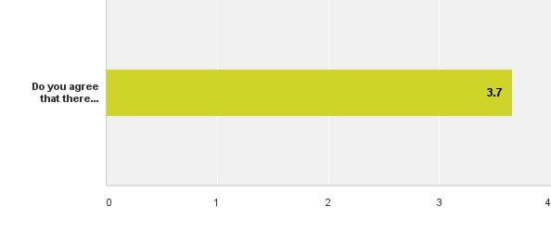
Q1: Objective 1: To Preserve and Enhance the Redington Frognal Neighbourhood Area Characteristics - Edwardian / Victorian architecture
Answered: 169 Skipped: 6

Slide 4
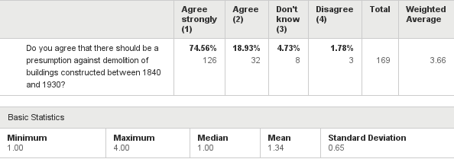
Q1: Objective 1: To Preserve and Enhance the Redington Frognal Neighbourhood Area Characteristics - Edwardian / Victorian architecture
Answered: 169 Skipped: 6

Slide 5
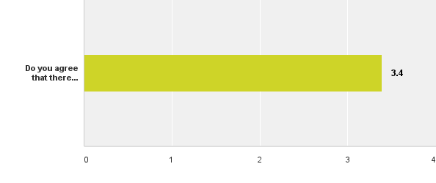
Q2: Objective 1: To Preserve and Enhance the Redington Frognal Neighbourhood Area Characteristics - modern architecture
Answered: 170 Skipped: 5

Slide 6
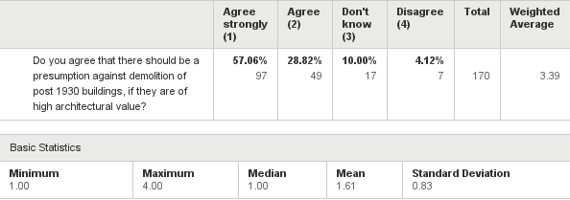
Q2: Objective 1: To Preserve and Enhance the Redington Frognal Neighbourhood Area Characteristics - modern architecture
Answered: 170 Skipped: 5

Slide 7
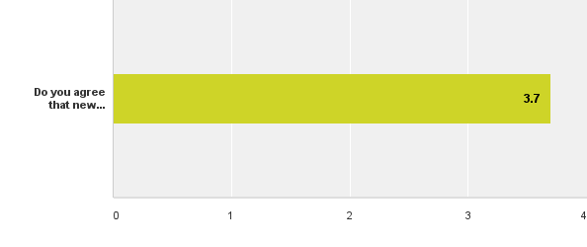
Q3: Objective 1: To Preserve and Enhance the Redington Frognal Neighbourhood Area Characteristics - building heights
Answered: 172 Skipped: 3

Slide 8
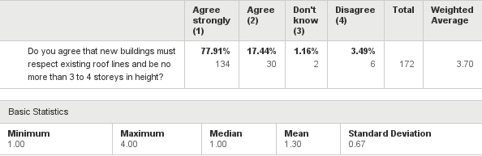
Q3: Objective 1: To Preserve and Enhance the Redington Frognal Neighbourhood Area Characteristics - building heights
Answered: 172 Skipped: 3

Slide 9
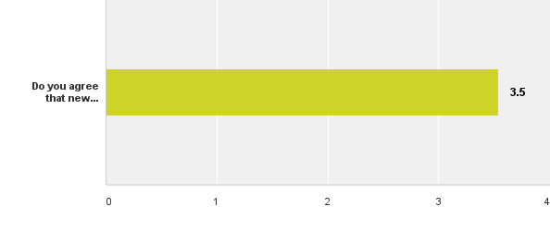
Q4: Objective 1: To Preserve and Enhance the Redington Frognal Neighbourhood Area Characteristics – gaps between buildings
Answered: 171 Skipped: 4

Slide 10
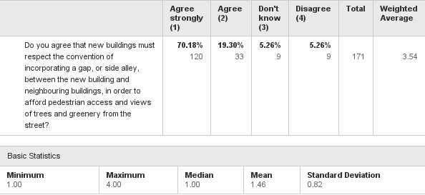
Q4: Objective 1: To Preserve and Enhance the Redington Frognal Neighbourhood Area Characteristics – gaps between buildings
Answered: 171 Skipped: 4

Slide 11
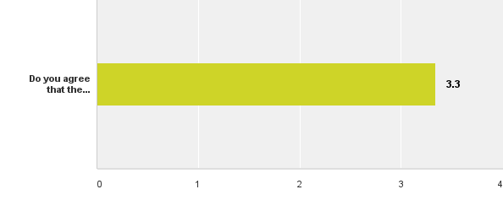
Q5: Objective 1: To Preserve and Enhance the Redington Frognal Neighbourhood Area Characteristics - footprint size
Answered: 168 Skipped: 7

Slide 12
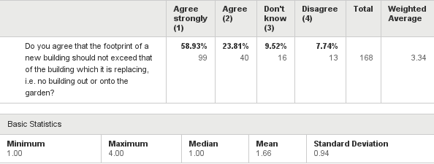
Q5: Objective 1: To Preserve and Enhance the Redington Frognal Neighbourhood Area Characteristics - footprint size
Answered: 168 Skipped: 7

Slide 13

Q6: Objective 1: To Preserve and Enhance the Redington Frognal Neighbourhood Area Characteristics – replacement of lost garden space
Answered: 169 Skipped: 6

Slide 14
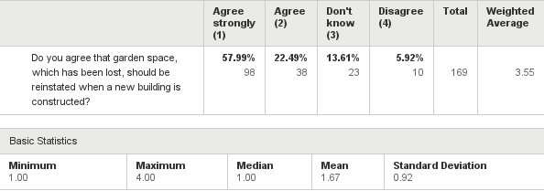
Q6: Objective 1: To Preserve and Enhance the Redington Frognal Neighbourhood Area Characteristics – replacement of lost garden space
Answered: 169 Skipped: 6

Slide 15

Q7: Objective 1: To Preserve and Enhance the Redington Frognal Neighbourhood Area Characteristics – retention of front and side gardens
Answered: 167 Skipped: 8

Slide 16
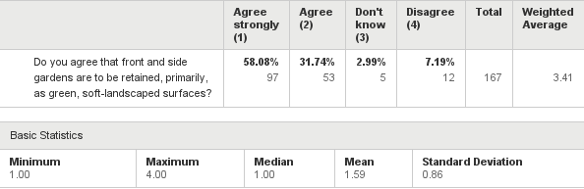
Q7: Objective 1: To Preserve and Enhance the Redington Frognal Neighbourhood Area Characteristics – retention of front and side gardens
Answered: 167 Skipped: 8

Slide 17
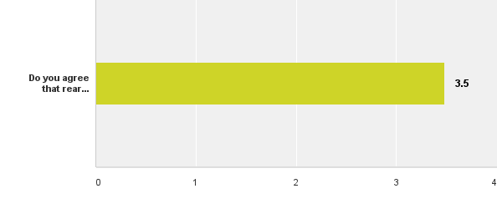
Q8: Objective 1: To Preserve and Enhance the Redington Frognal Neighbourhood Area Characteristics – preservation of rear gardens
Answered: 171 Skipped: 4

Slide 18
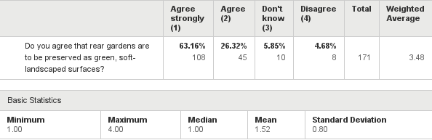
Q8: Objective 1: To Preserve and Enhance the Redington Frognal Neighbourhood Area Characteristics – preservation of rear gardens
Answered: 171 Skipped: 4

Slide 19
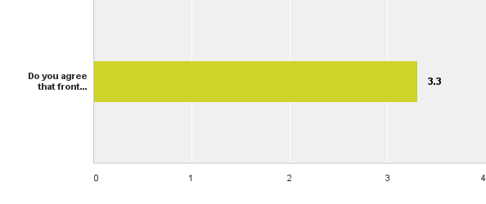
Q9: Objective 1: To Preserve and Enhance the Redington Frognal Neighbourhood Area Characteristics – preservation of front boundaries.
Answered: 172 Skipped: 3

Slide 20
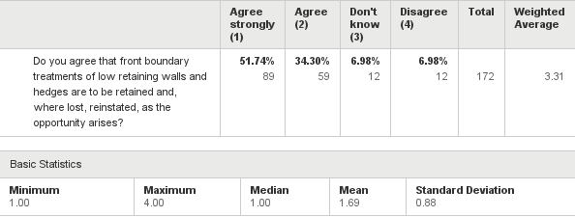
Q9: Objective 1: To Preserve and Enhance the Redington Frognal Neighbourhood Area Characteristics – preservation of front boundaries.
Answered: 172 Skipped: 3

Slide 21
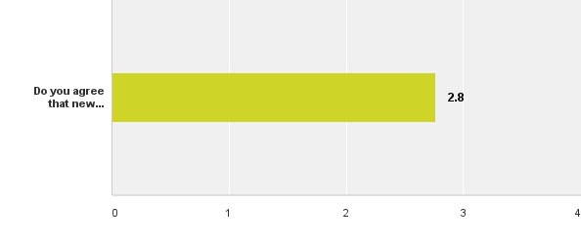
Q10: Objective 1: To Preserve and Enhance the Redington Frognal Neighbourhood Area Characteristics – new developments
Answered: 172 Skipped: 3

Slide 22
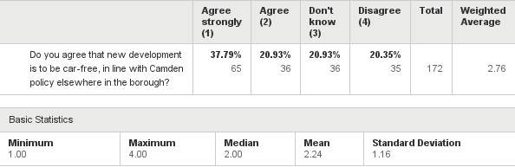
Q10: Objective 1: To Preserve and Enhance the Redington Frognal Neighbourhood Area Characteristics – new developments
Answered: 172 Skipped: 3

Slide 23
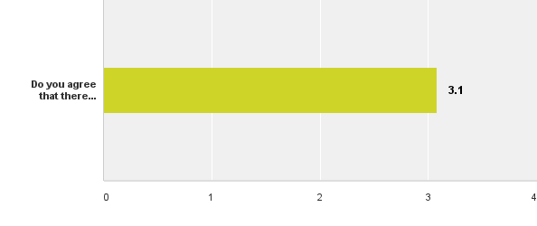
Q11: Objective 2: Greenery – Front garden car parks
Answered: 159 Skipped: 16

Slide 24
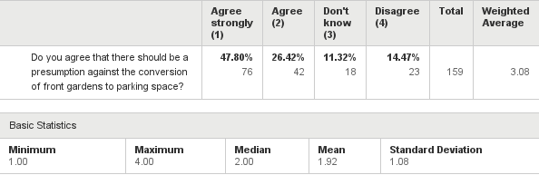
Q11: Objective 2: Greenery – Front garden car parks
Answered: 159 Skipped: 16

Slide 25

Q12: Objective 2: Greenery – Street trees and hedges
Answered: 166 Skipped: 9

Slide 26
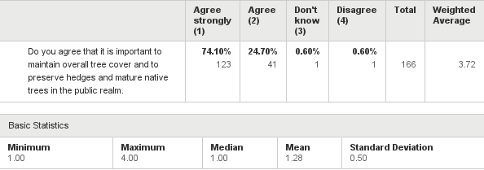
Q12: Objective 2: Greenery – Street trees and hedges
Answered: 166 Skipped: 9

Slide 27

Q13: Objective 2: Greenery - private trees and hedges
Answered: 168 Skipped: 7

Slide 28
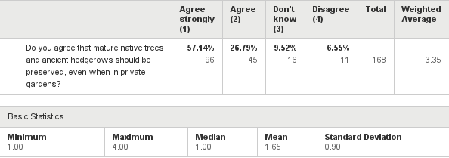
Q13: Objective 2: Greenery - private trees and hedges
Answered: 168 Skipped: 7

Slide 29

Q14: Objective 2: Greenery - hedges
Answered: 167 Skipped: 8

Slide 30
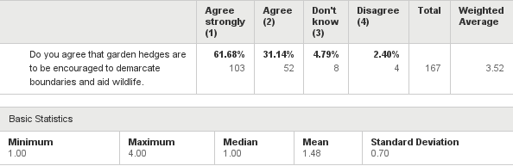
Q14: Objective 2: Greenery - hedges
Answered: 167 Skipped: 8

Slide 31

Q15: Objective 2: Greenery – Rear garden trees forming habitat corridors
Answered: 167 Skipped: 8

Slide 32
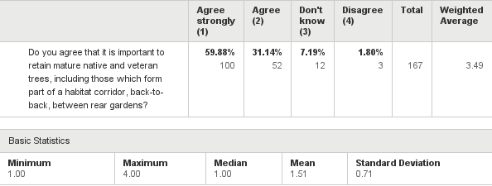
Q15: Objective 2: Greenery – Rear garden trees forming habitat corridors
Answered: 167 Skipped: 8

Slide 33

Q16: Objective 3: Greenery – succession planting
Answered: 168 Skipped: 7

Slide 34
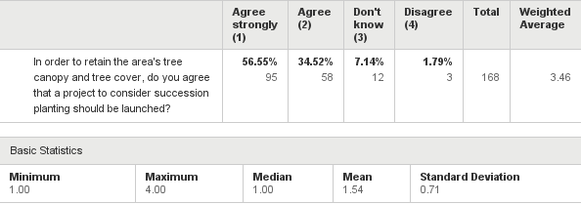
Q16: Objective 3: Greenery – succession planting
Answered: 168 Skipped: 7

Slide 35
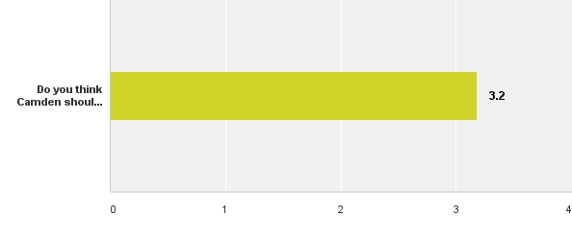
Q17: Objective 4: Enhancement of the Environment of Finchley Road – real-time air pollution visual displays
Answered: 156 Skipped: 19

Slide 36
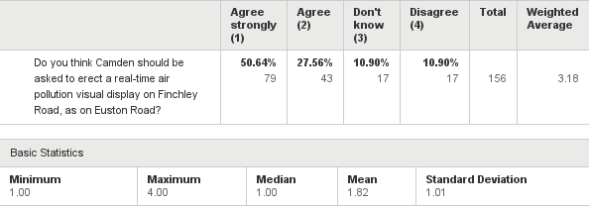
Q17: Objective 4: Enhancement of the Environment of Finchley Road – real-time air pollution visual displays
Answered: 156 Skipped: 19

Slide 37

Q18: Objective 4: Enhancement of the Environment of Finchley Road – prioritisation of walkability
Answered: 164 Skipped: 11

Slide 38
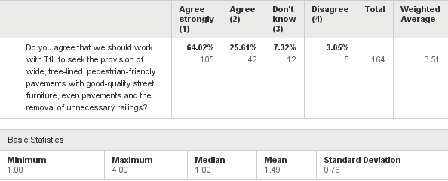
Q18: Objective 4: Enhancement of the Environment of Finchley Road – prioritisation of walkability
Answered: 164 Skipped: 11

Slide 39
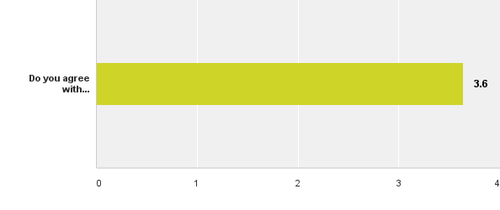
Q19: Objective 4: Enhancement of the Environment of Finchley Road – landscaping and greening
Answered: 165 Skipped: 10

Slide 40
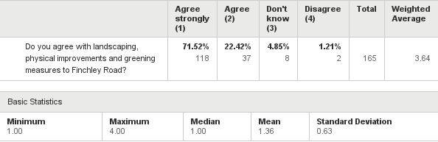
Q19: Objective 4: Enhancement of the Environment of Finchley Road – landscaping and greening
Answered: 165 Skipped: 10

Slide 41

Q20: Objective 4: Enhancement of the Environment of Finchley Road – a common utilities duct to enable tree planting along Finchley Road
Answered: 166 Skipped: 9

Slide 42
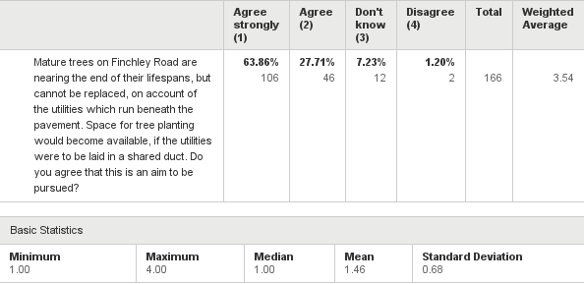
Q20: Objective 4: Enhancement of the Environment of Finchley Road – a common utilities duct to enable tree planting along Finchley Road
Answered: 166 Skipped: 9

Slide 43
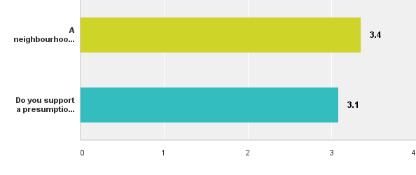
Q21: Objective 5: Sustainable Growth in Redington Frognal Neighbourhood Area – mega mansions
Answered: 159 Skipped: 16

Slide 44
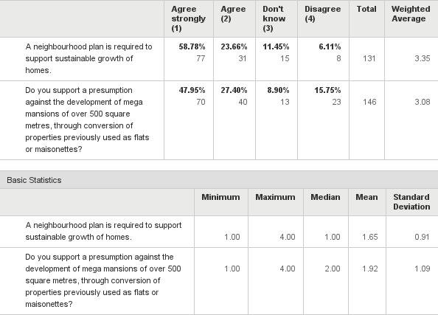
Q21: Objective 5: Sustainable Growth in Redington Frognal Neighbourhood Area – mega mansions
Answered: 159 Skipped: 16

Slide 45
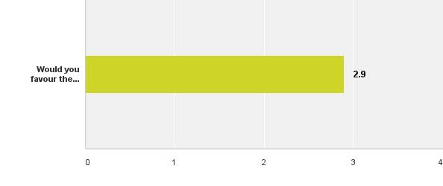
Q22: Objective 5: Sustainable Growth in the Redington Frognal Neighbourhood Area – sustainable growth of homes
Answered: 159 Skipped: 16

Slide 46
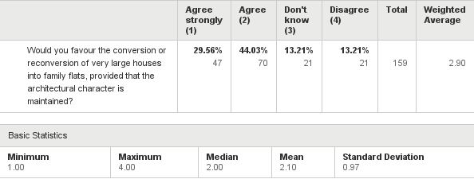
Q22: Objective 5: Sustainable Growth in the Redington Frognal Neighbourhood Area – sustainable growth of homes
Answered: 159 Skipped: 16

Slide 47
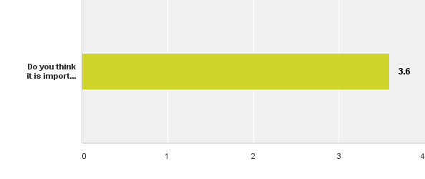
Q23: Objective 5: Sustainable Growth in Redington Frognal Neighbourhood Area – Finchley Road businesses
Answered: 159 Skipped: 16

Slide 48
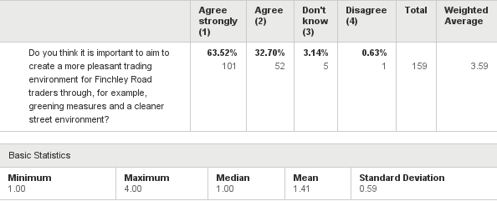
Q23: Objective 5: Sustainable Growth in Redington Frognal Neighbourhood Area – Finchley Road businesses
Answered: 159 Skipped: 16

Slide 49
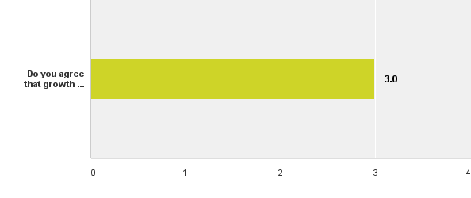
Q24: Objective 5: Sustainable Growth in Redington Frognal Neighbourhood Area - development of community space
Answered: 158 Skipped: 17

Slide 50
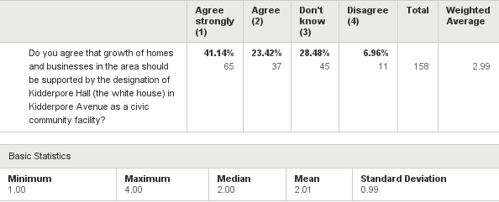
Q24: Objective 5: Sustainable Growth in Redington Frognal Neighbourhood Area - development of community space
Answered: 158 Skipped: 17

Slide 51
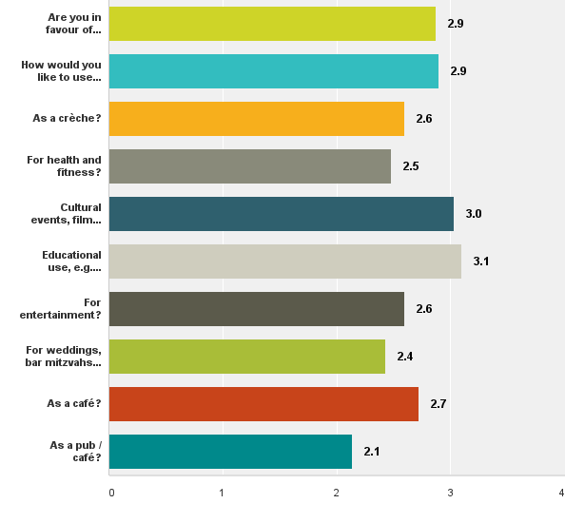
Q25: Objective 5: Sustainable Growth in Redington Frognal Neighbourhood Area – meeting the needs of families, home workers and the elderly. How might you like to make use of Kidderpore Hall?
Answered: 159 Skipped: 16

Slide 52
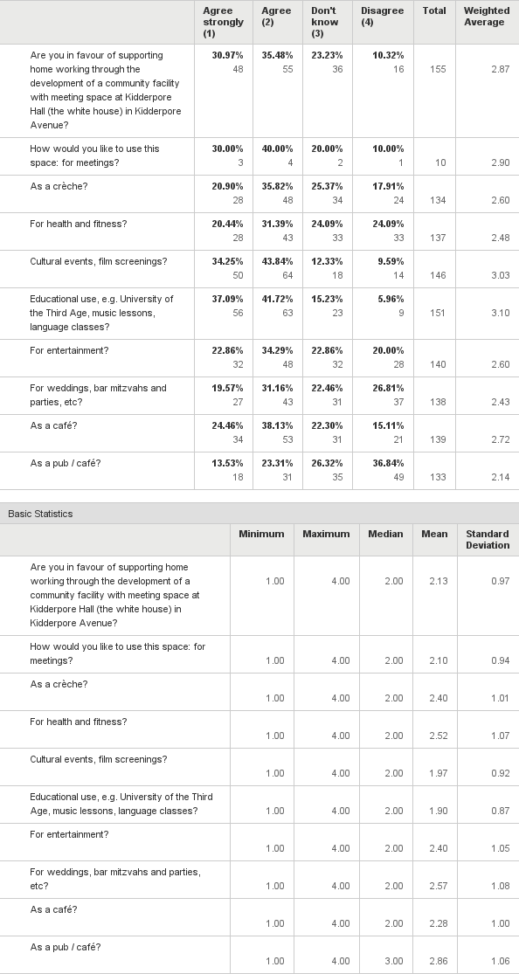
Q25: Objective 5: Sustainable Growth in Redington Frognal Neighbourhood Area – meeting the needs of families, home workers and the elderly. How might you like to make use of Kidderpore Hall?
Answered: 159 Skipped: 16

Slide 53

Q26: Objective 5: Sustainable Growth in Redington Frognal Neighbourhood Area - preservation of nature reserve and gardens to rear of Kidderpore Hall
Answered: 156 Skipped: 19

Slide 54
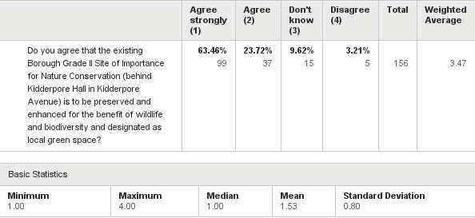
Q26: Objective 5: Sustainable Growth in Redington Frognal Neighbourhood Area - preservation of nature reserve and gardens to rear of Kidderpore Hall
Answered: 156 Skipped: 19

Slide 55

Q27: Objective 5: Sustainable Growth in the Redington Frognal Neighbourhood Area – West Heath Lawn Tennis Club
Answered: 160 Skipped: 15

Slide 56
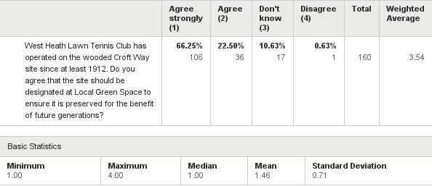
Q27: Objective 5: Sustainable Growth in the Redington Frognal Neighbourhood Area – West Heath Lawn Tennis Club
Answered: 160 Skipped: 15

Slide 57
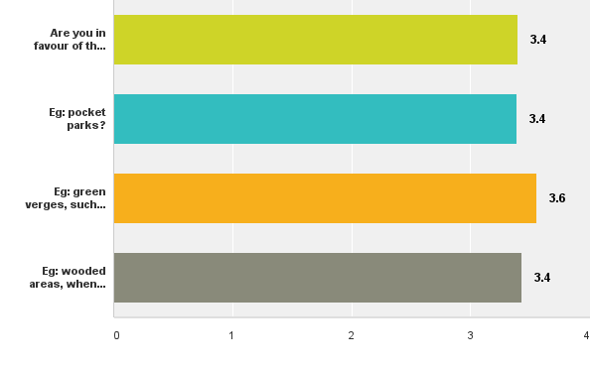
Q28: Objective 5: Sustainable Growth in the Redington Frognal Neighbourhood Area – other new Locally Protected Green Space
Answered: 159 Skipped: 16

Slide 58
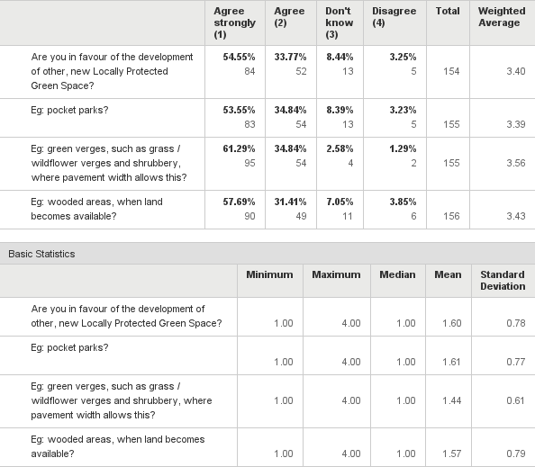
Q28: Objective 5: Sustainable Growth in the Redington Frognal Neighbourhood Area – other new Locally Protected Green Space
Answered: 159 Skipped: 16

Slide 59

Q29: Objective 5: Sustainable Growth in the Redington Frognal Neighbourhood Area – covered water reservoir in Platts Lane
Answered: 159 Skipped: 16

Slide 60
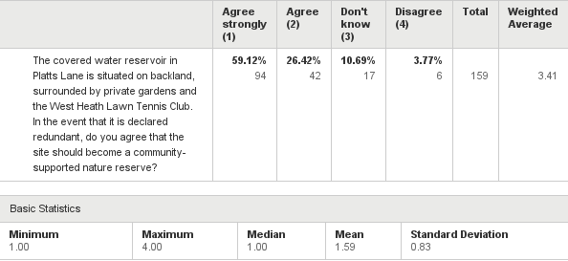
Q29: Objective 5: Sustainable Growth in the Redington Frognal Neighbourhood Area – covered water reservoir in Platts Lane
Answered: 159 Skipped: 16

Slide 61
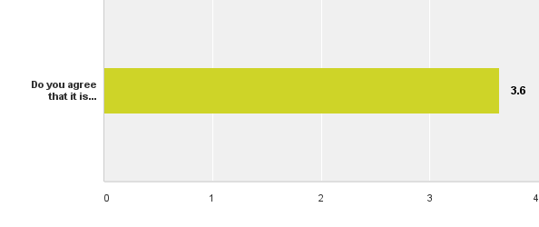
Q30: Objective 5: Redington Frognal Neighbourhood Area as Centre for Tertiary Education, the Arts and Culture - retention of community and cultural facilities
Answered: 157 Skipped: 18

Slide 62
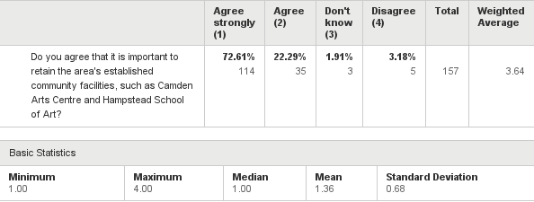
Q30: Objective 5: Redington Frognal Neighbourhood Area as Centre for Tertiary Education, the Arts and Culture - retention of community and cultural facilities
Answered: 157 Skipped: 18

Slide 63

Q31: Objective 6: Civic Pride
Answered: 158 Skipped: 17

Slide 64
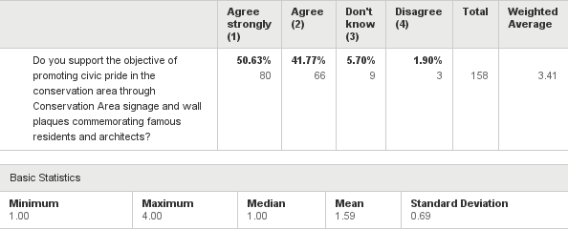
Q31: Objective 6: Civic Pride
Answered: 158 Skipped: 17

Slide 65
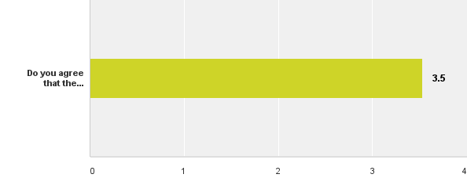
Q32: Objective 7: Basement Excavation - footprint size
Answered: 156 Skipped: 19

Slide 66

Q32: Objective 7: Basement Excavation - footprint size
Answered: 156 Skipped: 19

Slide 67

Q33: Objective 7: Basement Excavation - excavation depth
Answered: 154 Skipped: 21

Slide 68

Q33: Objective 7: Basement Excavation - excavation depth
Answered: 154 Skipped: 21

Slide 69

Q34: Objective 7: Basement Excavation - pavement licences
Answered: 157 Skipped: 18

Slide 70

Q34: Objective 7: Basement Excavation - pavement licences
Answered: 157 Skipped: 18

Slide 71

Q35: Other issues: car club space provision
Answered: 153 Skipped: 22

Slide 72

Q35: Other issues: car club space provision
Answered: 153 Skipped: 22

Slide 73

Q36: Other issues: controlled parking hours. Would you like to see an extension of the controlled parking hours in CA-S or CA-H?
Answered: 150 Skipped: 25

Slide 74

Q36: Other issues: controlled parking hours. Would you like to see an extension of the controlled parking hours in CA-S or CA-H?
Answered: 150 Skipped: 25

Slide 75

Q37: Other issues: school travel plans
Answered: 151 Skipped: 24

Slide 76

Q37: Other issues: school travel plans
Answered: 151 Skipped: 24

Slide 77

Q38: Other issues: provision of benches
Answered: 154 Skipped: 21

Slide 78

Q38: Other issues: provision of benches
Answered: 154 Skipped: 21

Slide 79

Q39: Other issues - underground rivers
Answered: 148 Skipped: 27

Slide 80

Q39: Other issues - underground rivers
Answered: 148 Skipped: 27

Slide 81

Q40: Other issues – paving stones in Arkwright Road
Answered: 58 Skipped: 117

Slide 82

Q40: Other issues – paving stones in Arkwright Road
Answered: 58 Skipped: 117

Slide 83

Q41: Other issues - street trees and trees with Tree Preservation Orders
Answered: 137 Skipped: 38

Slide 84

Q41: Other issues - street trees and trees with Tree Preservation Orders
Answered: 137 Skipped: 38

Slide 85

Q42: Vision and Objectives: Overall
Answered: 143 Skipped: 32

Slide 86

Q42: Vision and Objectives: Overall
Answered: 143 Skipped: 32

Slide 87

Q47: To comply with government legislation, our respondents must be statistically representative of the Fitzjohn's and Frognal ward. Please would you mind stating your age group
Answered: 150 Skipped: 25

Slide 88

Q47: To comply with government legislation, our respondents must be statistically representative of the Fitzjohn's and Frognal ward. Please would you mind stating your age group
Answered: 150 Skipped: 25

Slide 89

Q49: Do any members of your household work from home within the Redington Frognal Neighbourhood Area?
Answered: 150 Skipped: 25

Slide 90

Q49: Do any members of your household work from home within the Redington Frognal Neighbourhood Area?
Answered: 150 Skipped: 25

